Slide 1
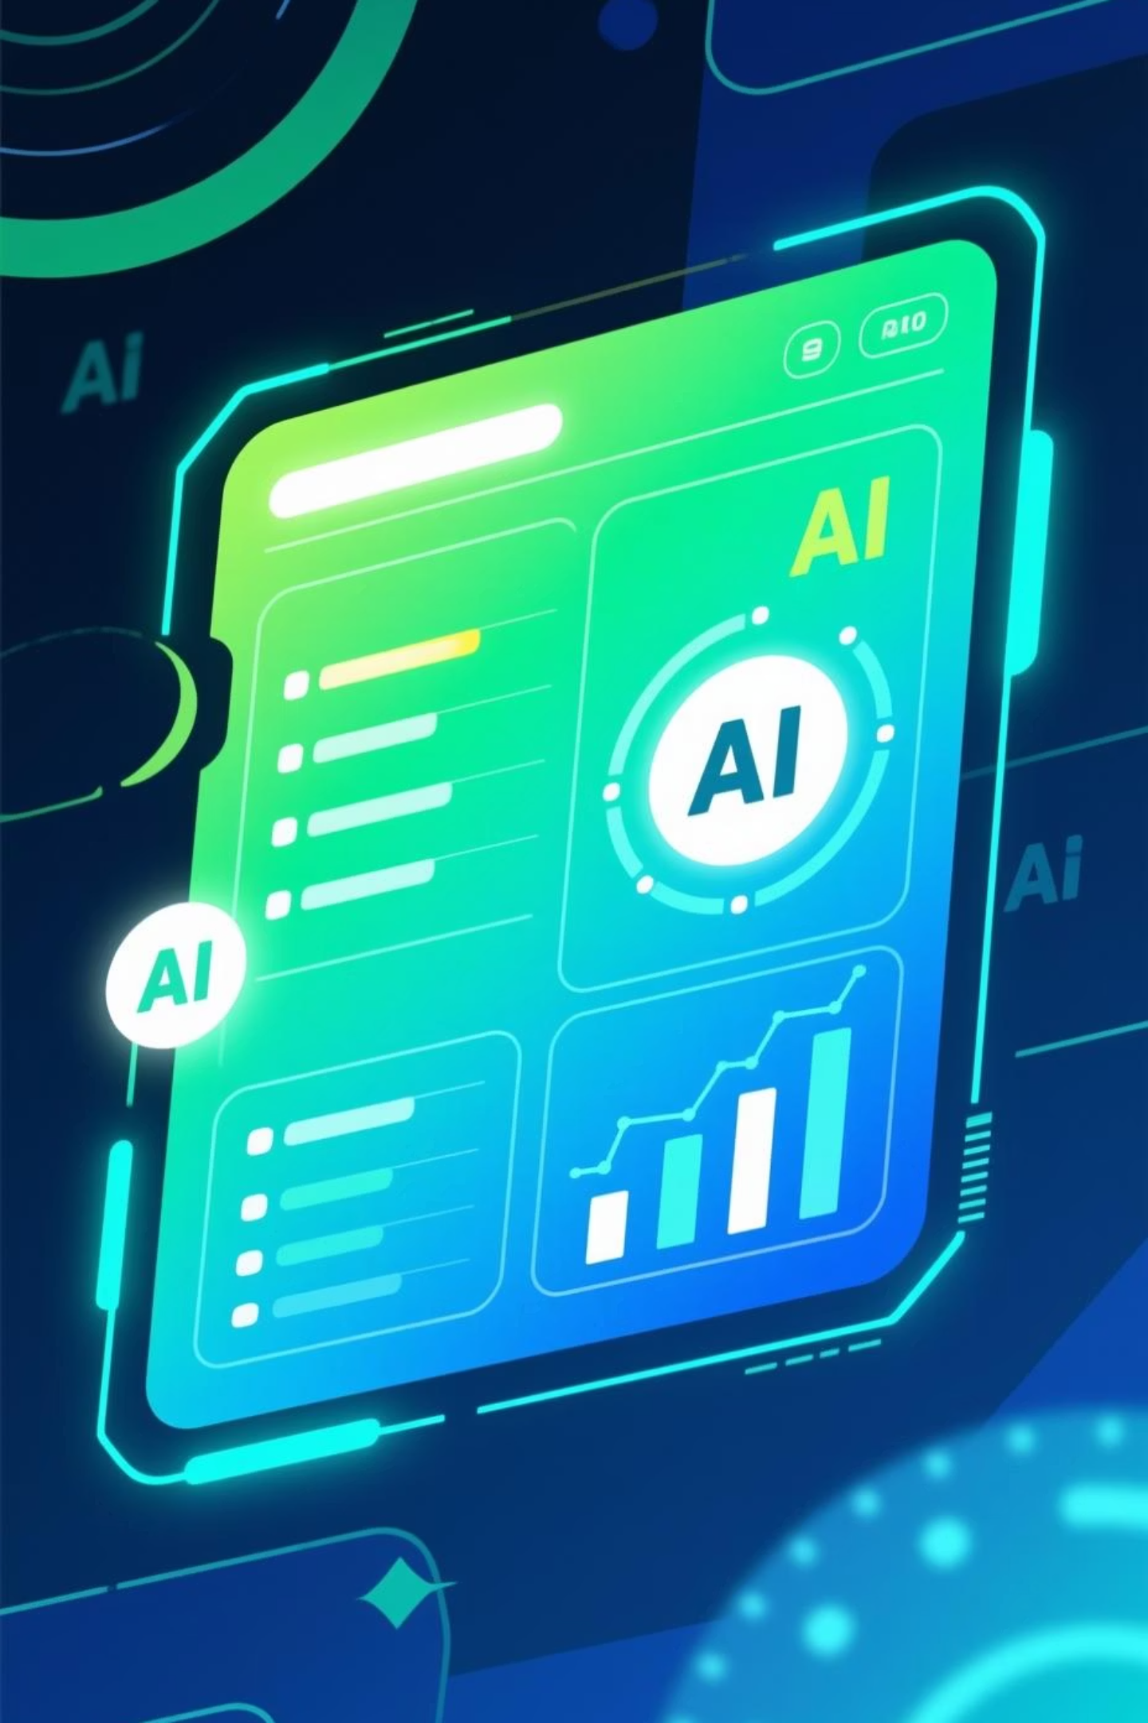
Perfect Pitch AI: Your Startup Launch-pad
Empowering founders with AI-driven pitch generation for rapid validation and growth.

Slide 2



Overview
Perfect Pitch AI
An AI-powered tool for startup founders to quickly generate comprehensive business pitches, assess viability, and receive actionable feedback.
AI-Driven Generation
Success Probability
Integrated Chatbot
Input bullet points, get a full pitch.
Assess idea viability with data.
Instant help and doubt resolution.

Slide 3
Core Functionality
Pitch Generation
Strategic Insights
Idea Validation
Elevator Pitch
Competitor Suggestions
Success Rate Prediction
Slide Bullet Points
Revenue Model Ideas
Strengths & Weaknesses
Catchy Tagline
Actionable Advice
Clear Value Proposition

Slide 4
Why It Matters: For Founders
Solving key pain points for early-stage entrepreneurs, especially during high-pressure events like hackathons.
Rapid Iteration
Structured Thinking
Confidence Boost
Quickly refine and test ideas.
Framework for comprehensive pitches.
Present with data-backed insights.

Slide 5
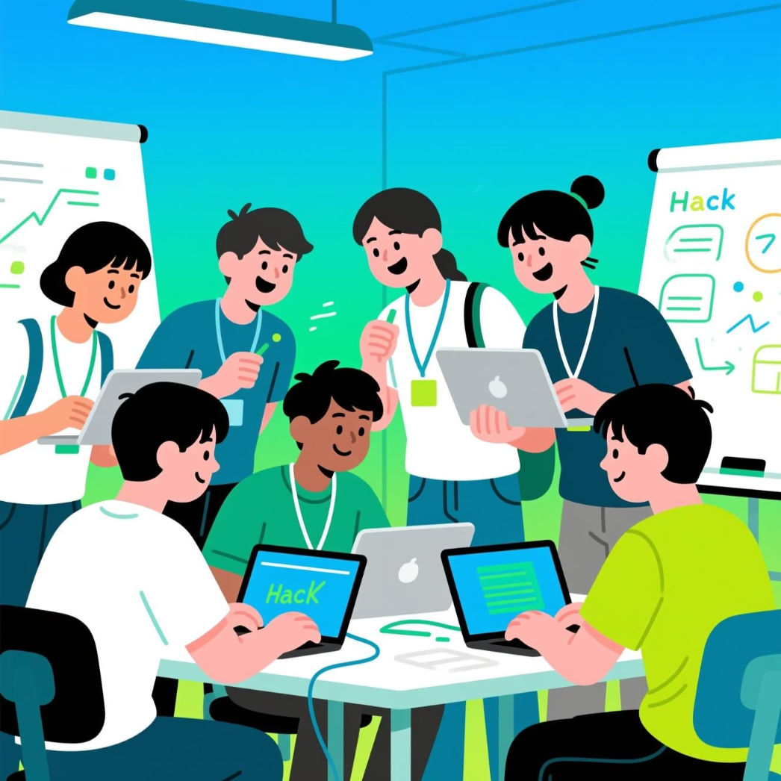
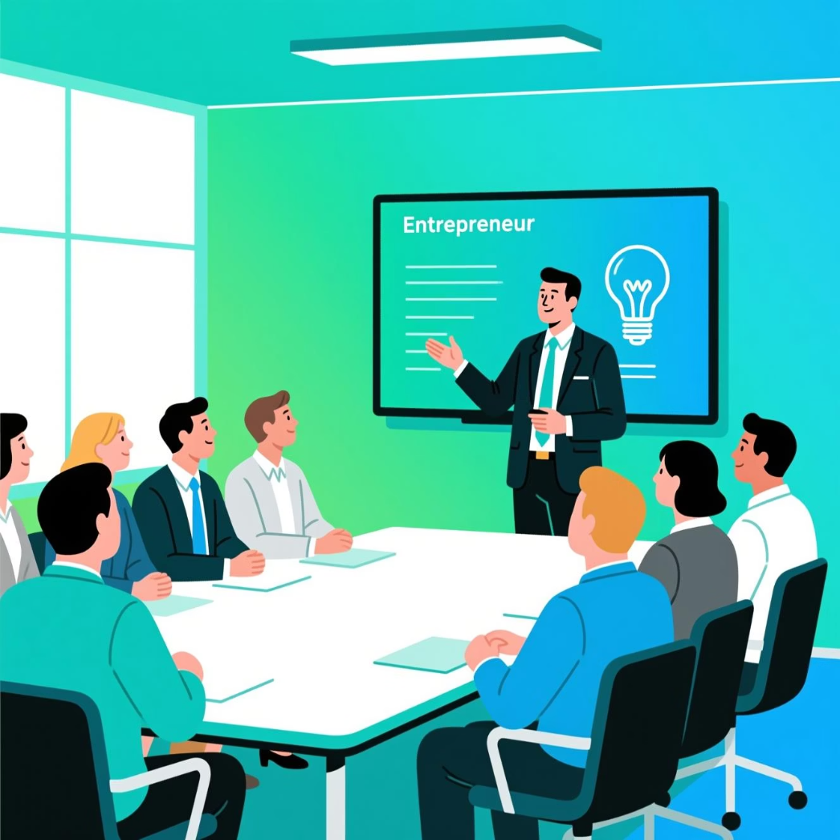

Use Cases
Ideal For:
Hackathons
Pitch Fests
Idea Validation
Generate pitches under tight deadlines.
Prepare compelling presentations.
Get initial feedback on new concepts.

Slide 6




Success Prediction Model
Leveraging data to provide a nuanced understanding of startup idea viability.
Data Input
Uses user-provided details.
Proprietary Algorithm
Analyzes market, team, and concept.
Probability Rate
Estimates success percentage.
Detailed Report
Strengths, weaknesses, advice.

Slide 7

Addressing Challenges: Deployment Discrepancies
Issue:
Inconsistent UI between local deployment and hosting environment.
This suggests environmental differences or build pipeline issues. We're prioritizing a robust CI/CD setup to ensure consistency.

Slide 8
Roadmap: Future Enhancements
Evolving Perfect Pitch AI to offer even deeper insights and broader utility.
01
02
Advanced Market Analysis
Investor Matching
Integrate real-time market data for competitor insights.
Suggest suitable investors based on pitch content and industry.
03
04
Pitch Deck Generation
Multi-Language Support
Automate full slide deck creation with design templates.
Expand to cater to a global user base.

Slide 9
Key Takeaways
1
2
3
Democratizing Pitching
Actionable Intelligence
Continuous Improvement
AI makes professional-grade pitches accessible to all.
Beyond generation, providing viability and advice.
Committed to addressing challenges and adding value.

